Slide 1
Object Oriented Programming

Slide 2
The basics

Slide 3
OOP (Object Oriented Programming)
Programming approach based on objects and classes.

Slide 4
OOP (Object Oriented Programming)
Object-oriented programming (OOP) is a programming paradigm based on the concept of "objects", which may contain data (fields or attributes) and code (procedures or methods).

Slide 5
OOP
The object oriented paradigm allows us to organise software as a collection of objects that consist of both data and behaviour.

Slide 6
Defining an object template

Slide 7
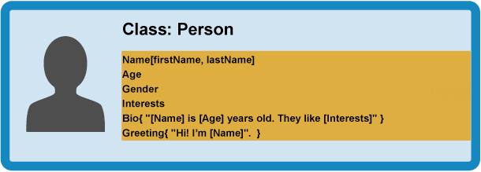
Abstraction (Class)
Creating a simple model of a more complex thing, which represents its most important aspects in a way that is easy to work with for our program's purposes

Slide 8
Encapsulation
Objects can contain related data and code, which represent information about the thing you are trying to model, and functionality or behavior that you want it to have.
ENCAPSULATION

Slide 9
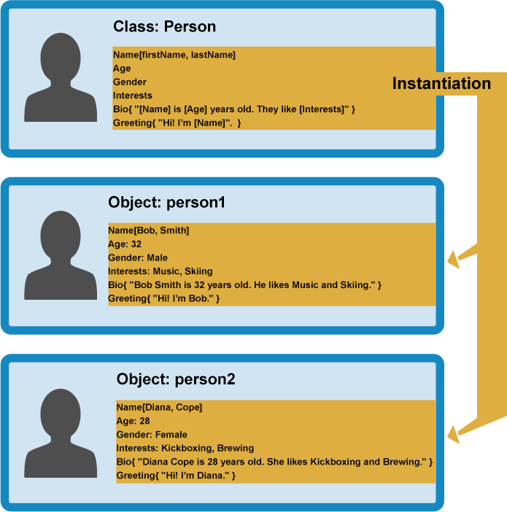
Creating actual objects (Instantiation)
From our class, we can create object instances — objects that contain the data and functionality defined in the class. From our Person class, we can now create some actual people:

Slide 10
Creating actual objects (Instantiation)
When an object instance is created from a class, the class's constructor function is run to create it. This process of creating an object instance from a class is called instantiation — the object instance is instantiated from the class.

Slide 11
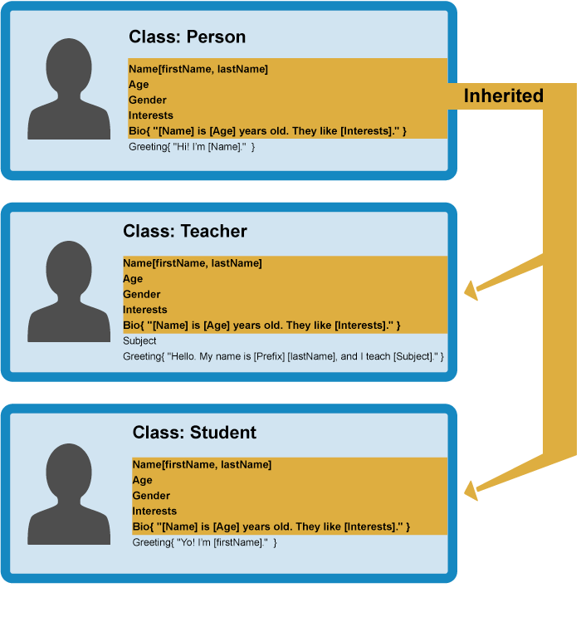
Specialist classes (Inheritance)
In OOP, we can create new classes based on other classes — these new child classes can be made to inherit the data and code features of their parent class, so you can reuse functionality common to all the object types rather than having to duplicate it.

Slide 12
Polymorphism
Where functionality differs between classes, you can define specialized features directly on them as needed. The fancy word for the ability of multiple object types to implement the same functionality is polymorphism.

Slide 13
Main concepts
Abstraction
Encapsulation
Inheritance
Polymorphism

Slide 14
OOP in
Real World

